Slide 1
Strategy Design Pattern
-real case use-
Author : Ciucur Daniel

Slide 2

The idea
Log the orders of our employees in a document
Give employees discounts based on their rank in the company!

Slide 3

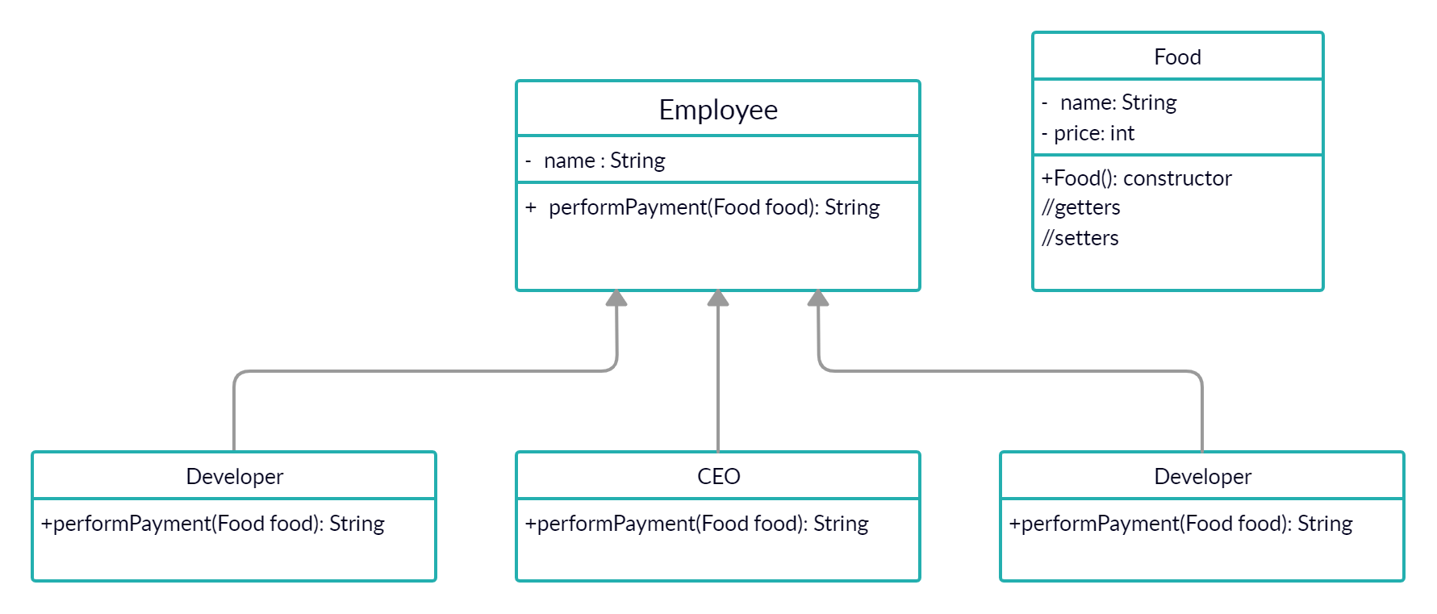
Solution

Slide 4

Is this really the good approach?
Well sure no!

Slide 5
Why is it bad?
-By using inheritance we will need to implement the “performPayment” method in every class, even if, let’s say a “MANAGER” and a “DEVELOPER” have the same discount or offer.
In software development one thing is for sure: CHANGE
Changes will be hard to track and resolve, with means we will have a hard time maintaining and debugging our code

Slide 6
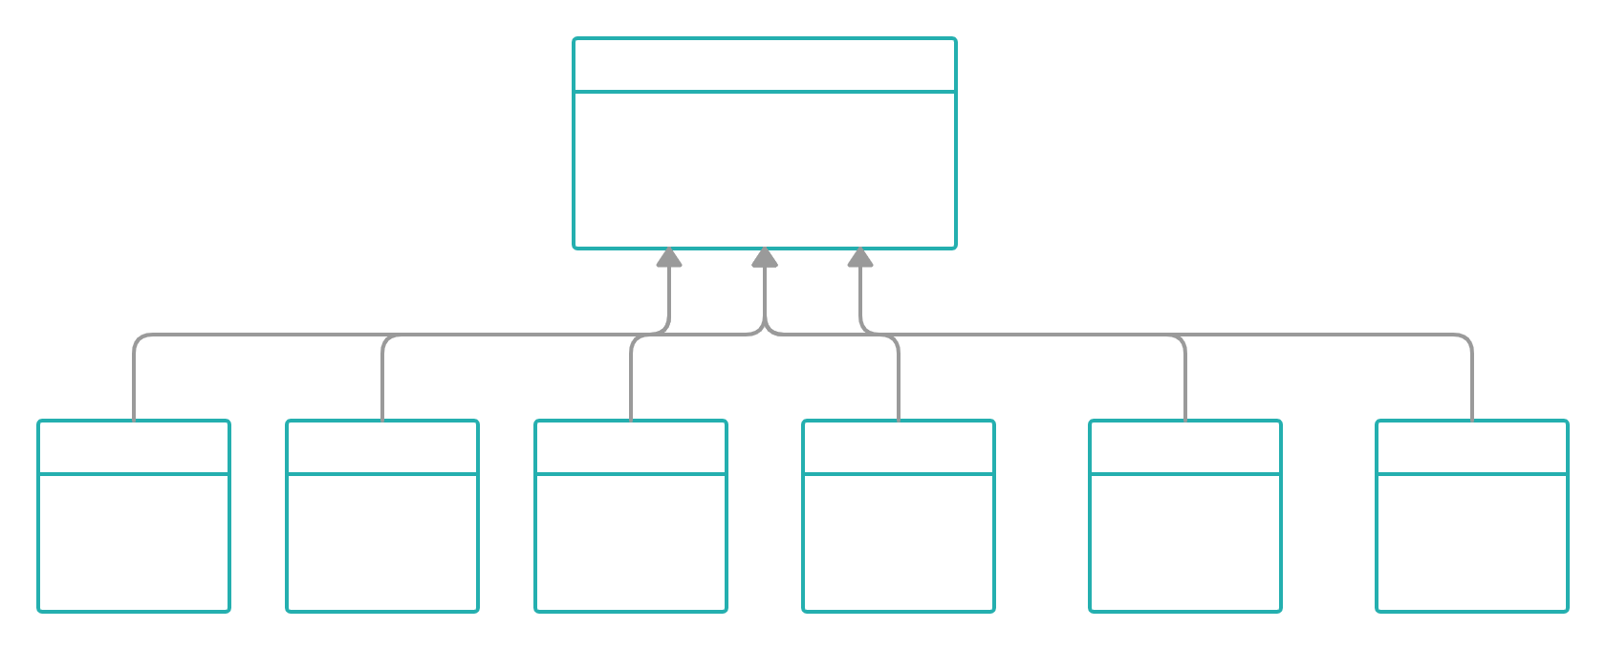
If we have many employees, it becomes more clear why the design is bad
Duplicate code
Hard to track changes for all classes
Can’t change at runtime!
FREE
25%off
25%off
25%off
75%off
10%off

Slide 7

In this case we notice we can use a Design Pattern

Slide 8
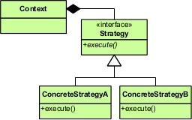
Strategy Pattern

Slide 9
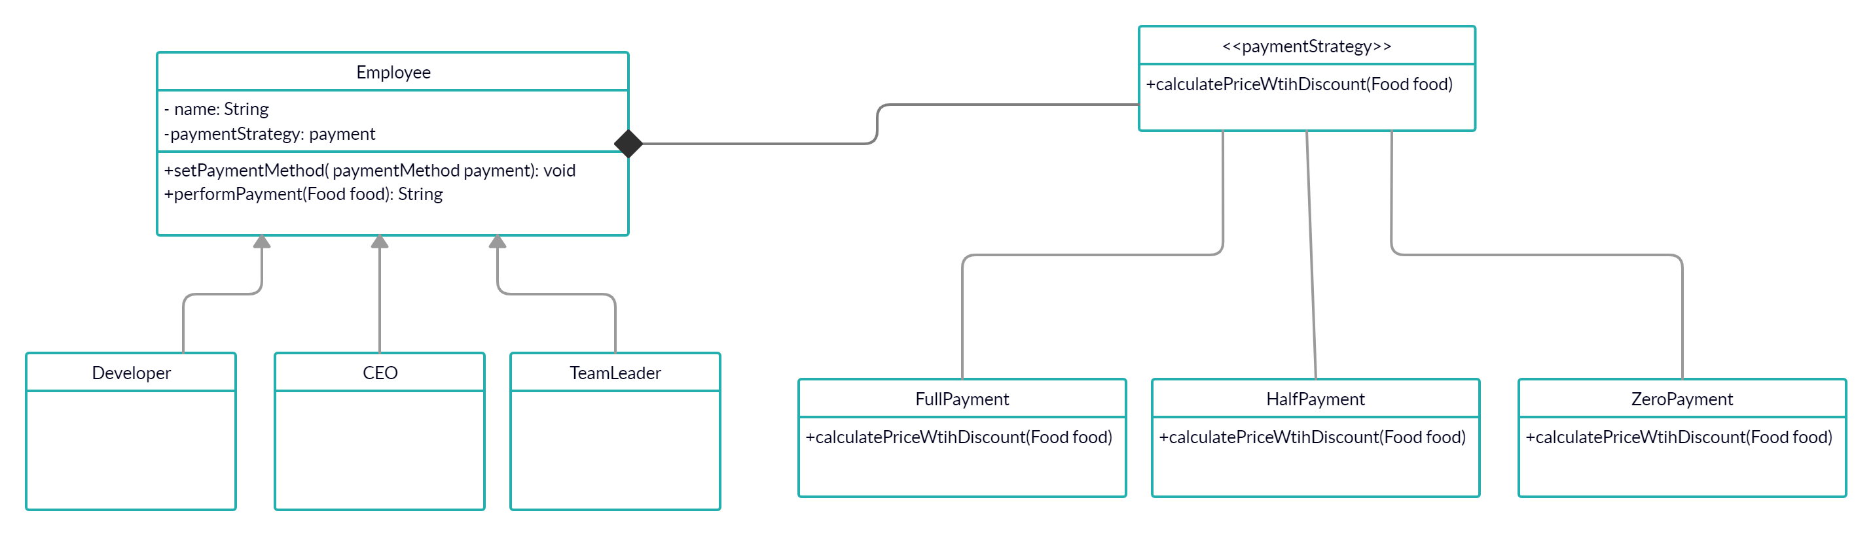

Slide 10
Advantages of Strategy Pattern
Strategy Pattern
Normal design
Uses composition
The class is decoupled from the behavior
Can change behavior at design time and also at run-time
Easy to maintain even when code gets bigger
Uses inheritance
Implement behavior in every subclass
Can only change behavior at design time
Pretty hard to maintain and easy to mess up with

